Slide 1
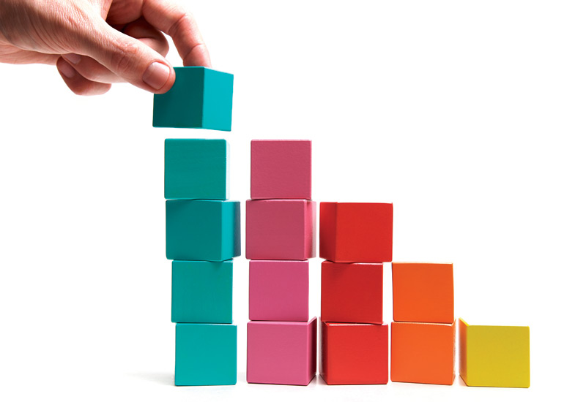
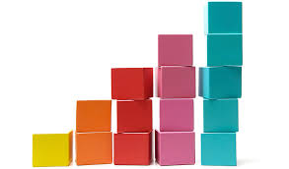
Blocks on Blocks on Blocks on Blocks on Blocks on Blocks on Blocks on Blocks on Blocks on Blocks on Blocks on Blocks on Blocks on Blocks on Blocks on Blocks on Blocks on Blocks on Blocks on Blocks on Blocks on Blocks on Blocks on Blocks on Blocks on Blocks on Blocks on Blocks on Blocks on Blocks on Blocks on Blocks on Blocks on Blocks on Blocks on Blocks on Blocks on Blocks on Blocks on Blocks on Blocks on Blocks on Blocks on Blocks on Blocks on Blocks on Blocks!
Dynamically Rearranging Synteny Blocks in Comparative Genomes
Nick Egan’s Final Project Presentation for BIO 131
Intro to Computational Biology
Taught by Anna Ritz

Slide 2
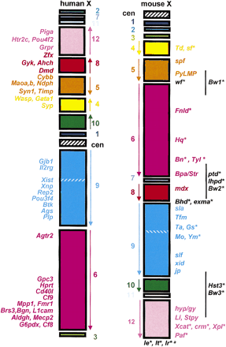
Blocks? What’s the big idea?
Can you compare genomes’s synteny blocks without knowing what those synteny blocks are?
How do you compute the number of rearrangements from one piece of DNA to another?

Slide 3
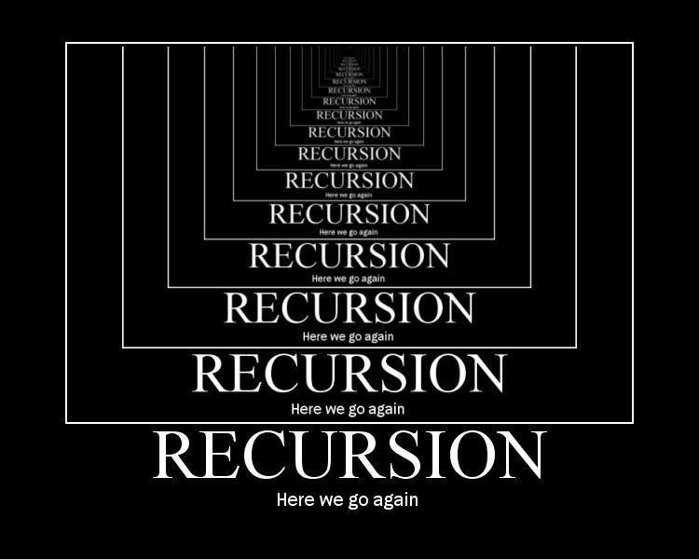
How do we solve it?
def massFlipper(s1, s2, dictionary):
#Input: Two strings #Output: Array that indicates the best scoring sequence of flips
for i in range(len(s1)):
for n in range(i, len(s1)):
whatWillFlip = s1[i:n+1]
allFlipHolder.append(toBeAdded)
tempList = [whatWillFlip]
sequenceFlipRecorder[toBeAdded] = tempList
‘’’
‘’’
for i in range(len(sequencesToExamine)):
dictionary = massFlipper(sequencesToExamine[i], s2, dictionary)

Slide 4
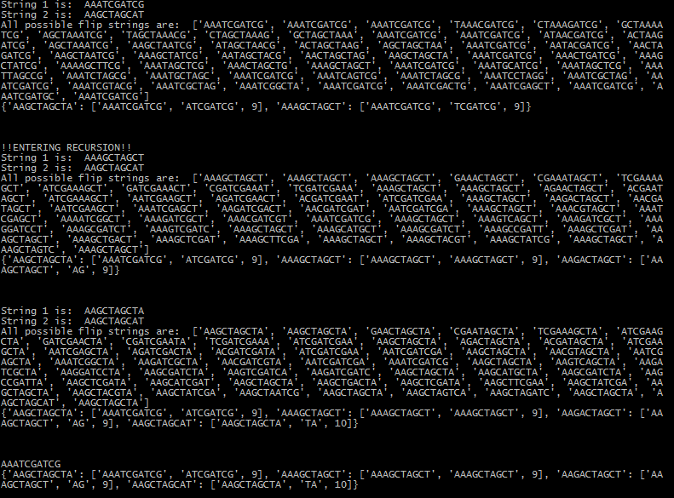

Slide 5
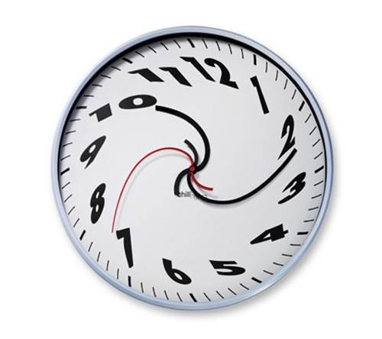
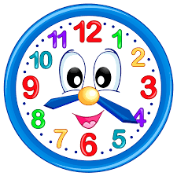
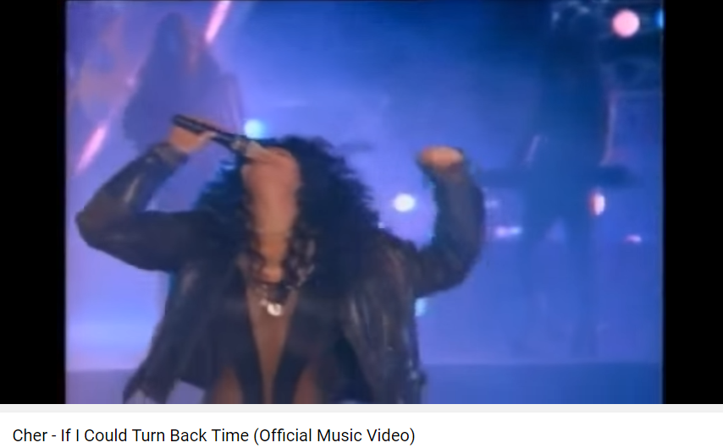
Difficulties
R U N T I M E
Retaining sequence of flips
Converting to GraphSpace
Circularizing the genome?

Slide 6
Next Steps/Results
Use sequence of flips to construct a graph that shows possible evolutionary path.

Slide 7
Thank you for listening!
Nick Egan
Acknowledgments
Thanks to all my classmates for tolerating me in conference this semester.
Thanks to Anna Ritz for teaching this course, as well as providing mentorship and support.
Thanks to Mina for providing so much tutorship!
And thanks to biology being so dang complicated!

